Slide 1
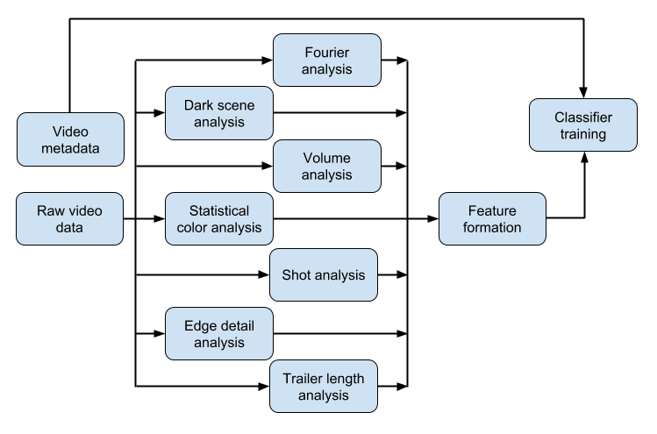
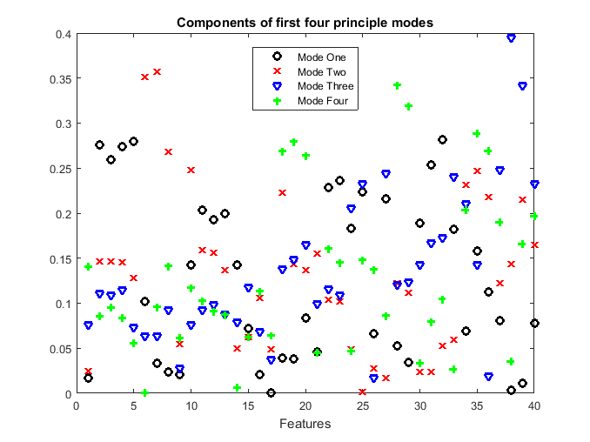
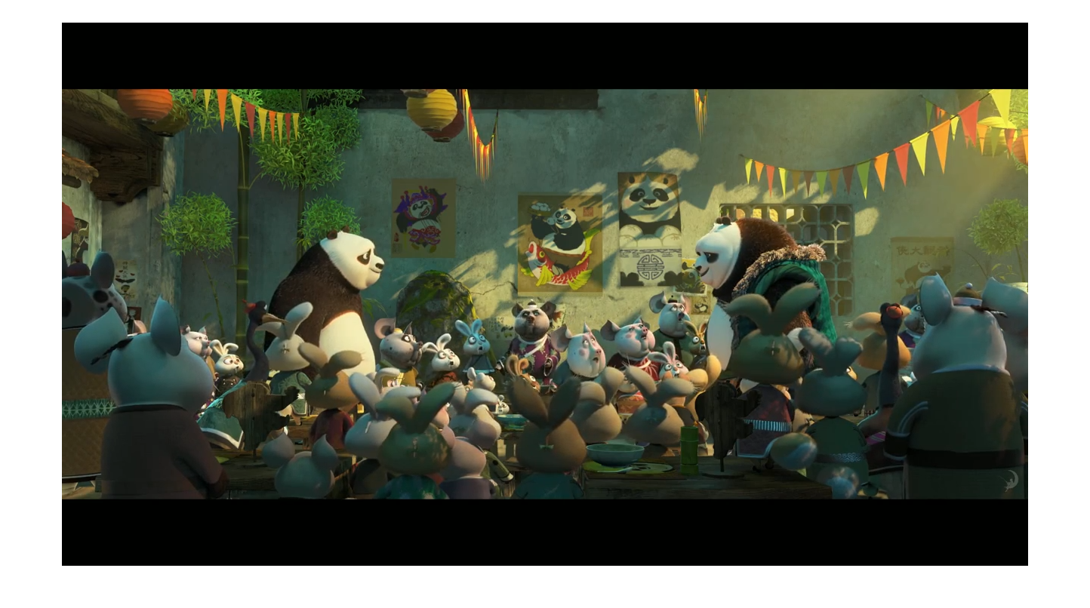
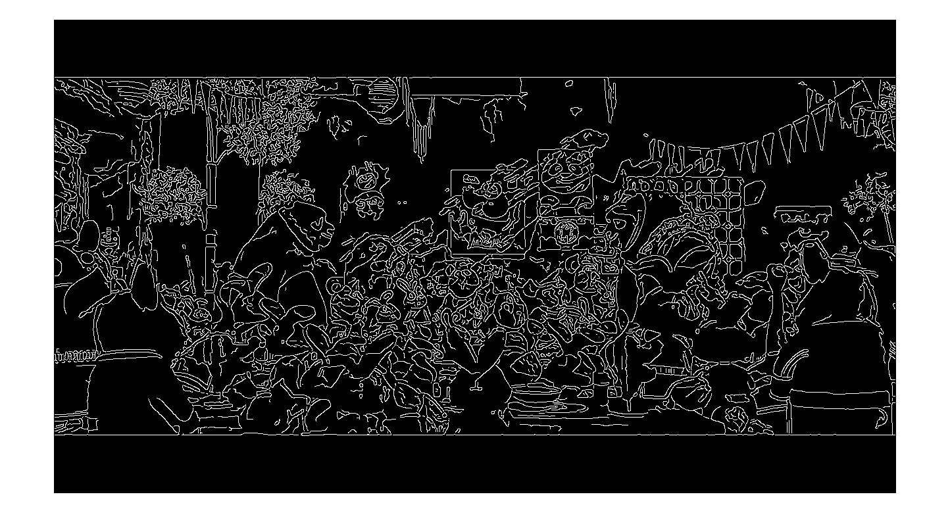
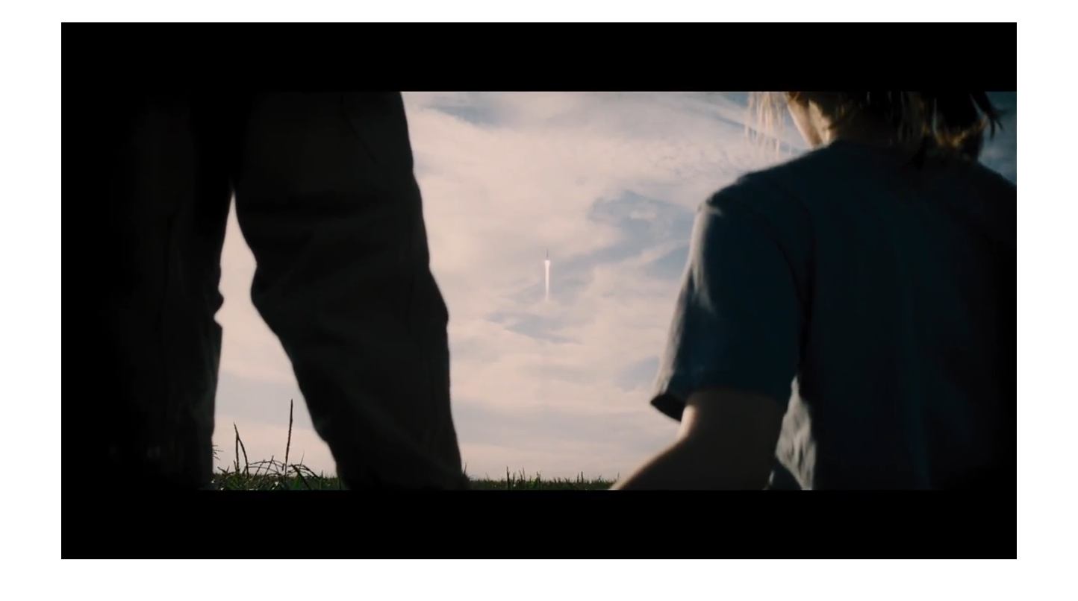
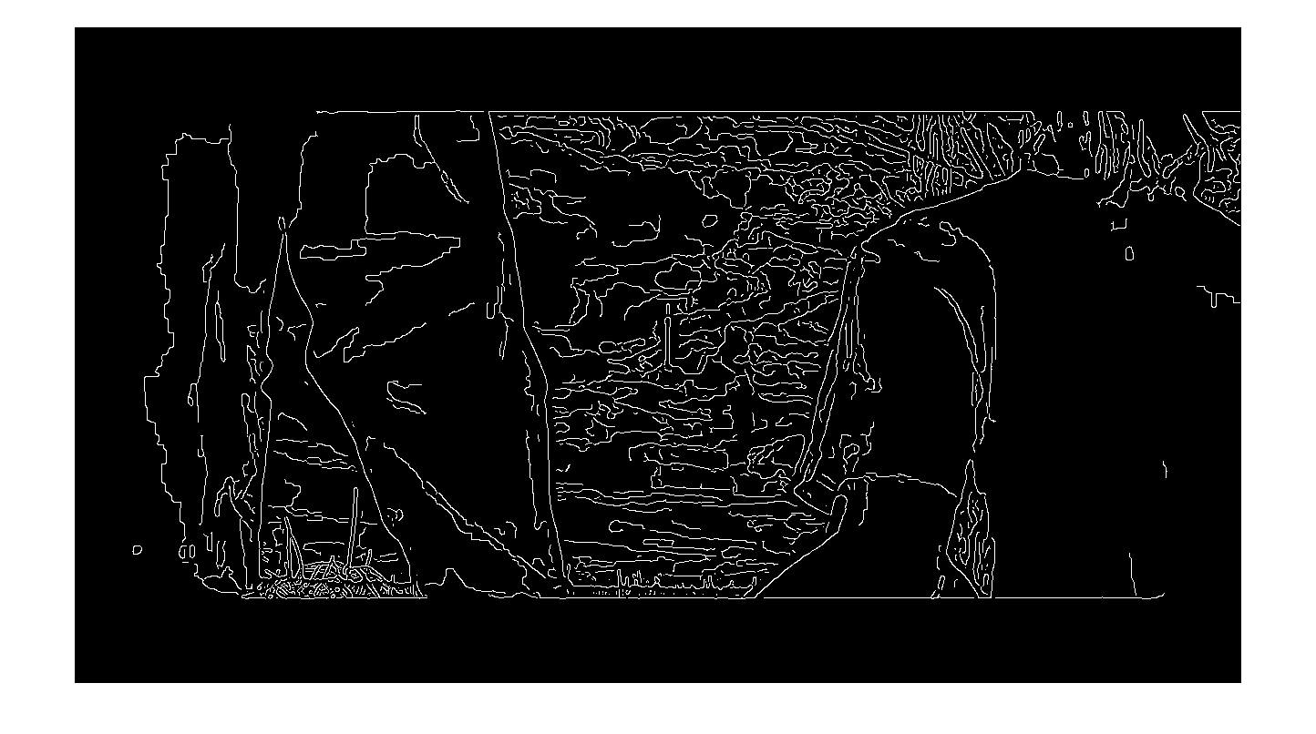
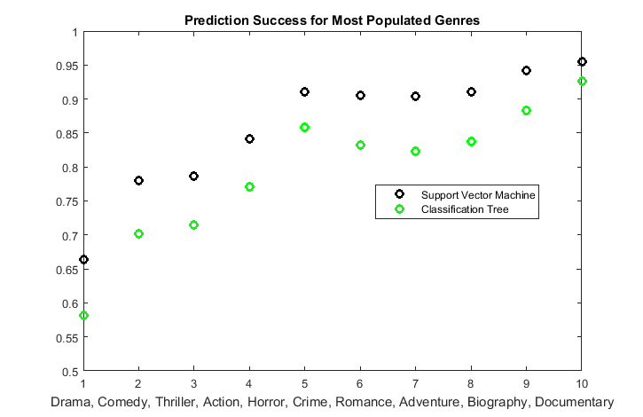
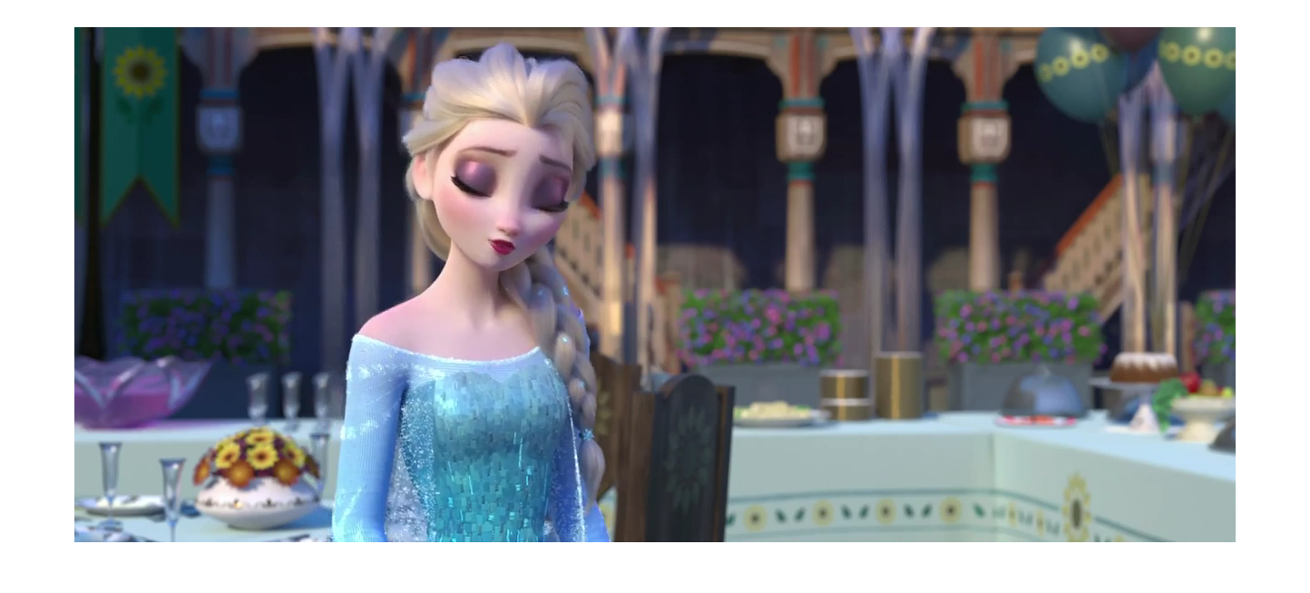
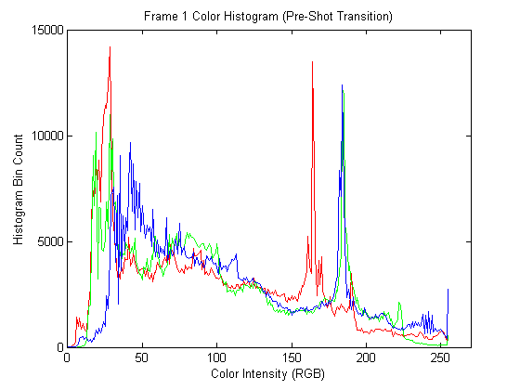
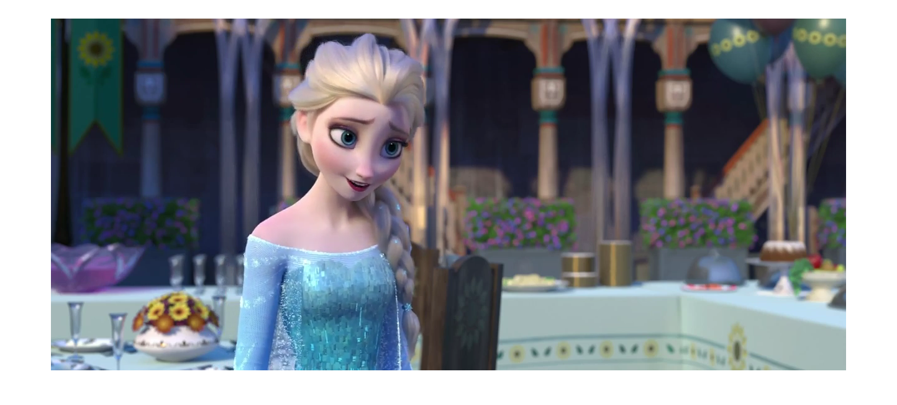

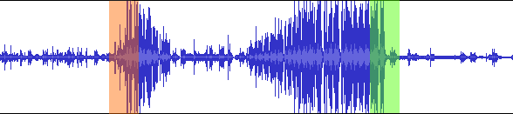
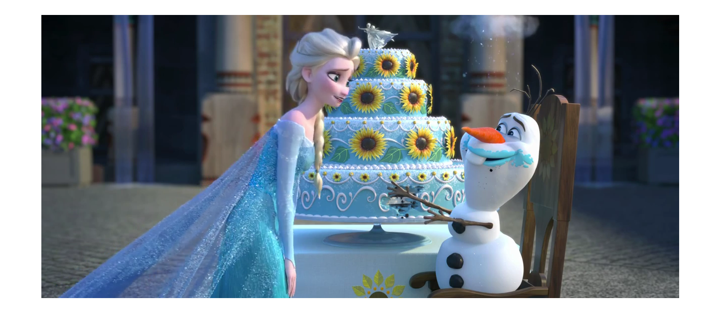
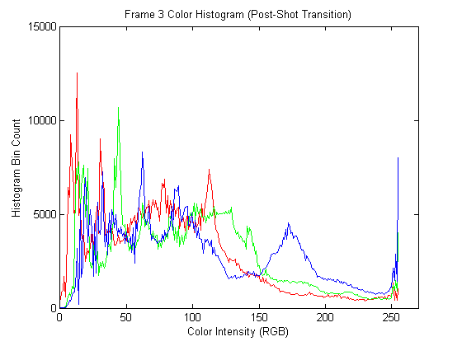
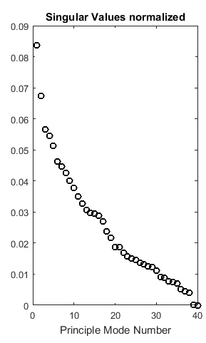
Multimedia Feature Generation of Movie Trailers for Genre Prediction
Nathaniel Guy, John Fuini and Yong Han Noel Kim
University of Washington, Computer Science & Engineering/Aeronautics & Astronautics
MOTIVATION
MOVIE FEATURE GENERATION (cont.)
RESULTS (cont.)
Movie trailers are one of the most effective advertising tools for movies. Human movie viewers can tell the genre of a movie given the first minute of watching its trailer. Viewers have developed this cognitive ability by watching countless movies of various genres over time, and have subconsciously associated certain cinematic features with certain genres.
We aimed to develop an algorithm that mimics this process for computers. There were two major parts to this endeavor. One, is the process of identifying cinematic features from a large set of trailers of known genre, and two, is training a machine learning algorithm to develop classification criteria based on these features and genre metadata.
Lastly, the generated classification criteria was tested on a set of trailers to assess the effectiveness of our approach.
VI. Detail Score
We used Canny edge detection filter [2] to find average detail per frame.
MOVIE FEATURE GENERATION
A pipeline of overall algorithm
Video Features
A large part of our features were generated via computer vision analysis package: OpenCV2 written in Python [1].
I. Total run-time
CV2 can provide the frames per second (FPS) for a given trailer as well, and this allowed us to calculate the run-time of trailers in seconds.
II. Number of frames
OpenCV allows the processing of video data on a per-frame basis. Individually frames were counted, in order to get a total run-time of any given trailer in terms of frame count.
III. Number of shots
We detected shot transitions by examining the color histogram for each frame, and detecting a drastic change in color histogram.
RESULTS
Edge detection filter measuring different detail score for frames with different level of detail. (top) Kung Fu Panda, Animation-Comedy (bottom) Interstellar, Adventure.
The rate of successive classification by our algorithm for top ten most popular genres are shown below. The Drama genre had the lowest success rate, with 58% and 66% successful classification for binary decision tree and SVM respectively. The rest of genres registered consistently over 70% success rate. SVM had roughly 8% higher success rate overall for a given genre than binary decision tree.
VII. Dark Scenes
A “dark scene” was defined as consecutive frames with dark transitions. We measured average lengths of such scenes, standard deviation of length, min. and max. length, and the percentage of dark scene in a given trailer.
CONCLUSIONS AND FUTURE WORK
The project demonstrated a construction of movie genre classifier using features acquired from videos and audios portions of movie trailers. A series of video analysis using computer vision module generated myriad of video-features such as detail score, dark scene, color and intensity profile etc. Temporal and frequency analysis of audio identified sharp increase and decrease of volume and frequency spectra. MATLAB classifiers trained using these features classified movie genres with success rate ranging from 60% to 95%. Of two classifiers, binary decision tree and support vector machine, the later had appx. 8% higher chance of successful classification overall.
It is worth noting that our machine learning algorithm is unsupervised. The only step necessitates human input is providing genre classification for the set of movie trailers initially. The rest of the pipeline could easily be automated. While in this project we tested our algorithm using movie trailers, it can be adapted to any environment that require computer vision-audio based machine learning. This can include surveillance, video tracking, etc.
Audio Features
I. Volume
The mean, standard deviation, min. and max. volume features were acquired from the audio waveforms.
II. Sudden rise/fall
Sudden increase and decrease of were defined as change in volume in a small time period with a magnitude of change larger than the standard deviation of volume.
A sample waveform showing a sudden rise (red) and a sudden fall (green)
Performing singular value decomposition (SVD) on the feature set could provide covariance of principle modes in the set.
III. Frequency components of audio
The frequencies residing in an audio track was analyzed via Fast Fourier Transform. They were bucketed into standard eleven octave bands, and the percentage of each octave in the given trailer was noted.
Aside from the first two modes, the covariance of the principal modes decreased steadily. Note that these modes are not equivalent to features, but rather a combination of features present in the set. For example, in the figure below one can observe how mode one through four consist of varying degree of combination of all the features.
The first mode captures appx. 8.5% of the energy in the feature set. We performed a dimensional reduction by making classifications using the first mode only. Surprisingly, the difference of success rate between one-mode and full-mode was less than 10%.
MACHINE LEARNING ALGORITHM
REFERENCES
A subset of the trailers, composed of 80% of randomly chosen movie trailers, was built. This set, called a trainer set, was used to build a binary classification tree in MATLAB environment. (command: fitctree) This tree was then tested on the full set of trailers to classify their genres. (command: predict). The result was then compared with the actual genres of movie trailers to assess the success rate of this algorithm. This process was repeated 40 times to cross-validate.
The binary decision tree seemed to provide adequate success rate. Nonetheless, we experimented with support vector machine (SVM) model as well. The classifier was created (command: fitcsvm), used for classification, the result was cross-validated (command: crossval), and their accuracies were noted (command: kfoldLoss).
[1] OpenCV. Itseez. Web. 09 Mar. 2016. http://opencv.org/.
[2] Canny, J., A Computational Approach To Edge Detection, IEEE Trans. Pattern Analysis and Machine Intelligence, 8(6):679–698, 1986
A demonstration of shot transition detection. The histograms pertaining to the same shot (top, middle) share similar color histogram, while the one for a different shot (middle) display different color components. (Frozen, animation)
IV. Shot length
Once the shot transitions were identified, we could get statistics such as: average shot length, min. and max. shot length, and their standard deviations as well.
V. RGB Component
R, G and B components denote the proportion of red, green and blue colors for a given pixel. We calculated the average intensities along each of these color channels, across pixels and across all frames.
ACKNOWLEDGEMENTS

